Slide 1


SAFE HILLS
Uttarakhand
SAFE HILLS
UTTARAKHAND
Predict - Prepare - Prevent
Presented by- TEAM CAD
Charvi (24113033) - Contributed majorly to app development and presentation design. Also worked on report compilation and supported dataset processing.
Ayush Aary (24113028) - Worked on report writing and documentation, refined model explanation, and contributed to debugging and resolving the code errors.
Disha Agrawal (24113039)-Played a key role in coding and dataset collection. Also contributed significantly to presentation and report preparation.

Slide 2
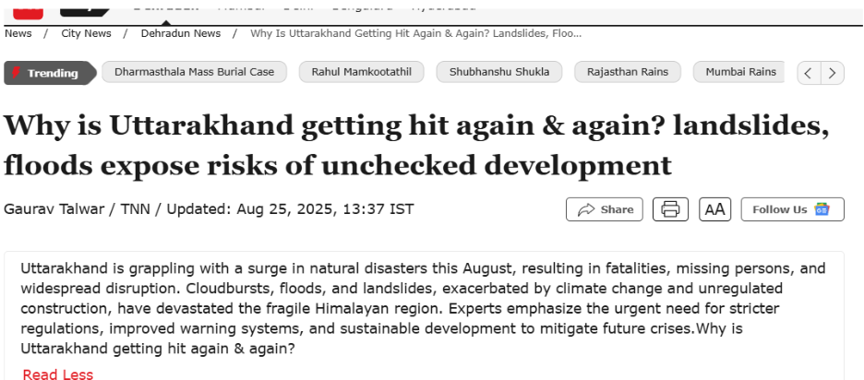
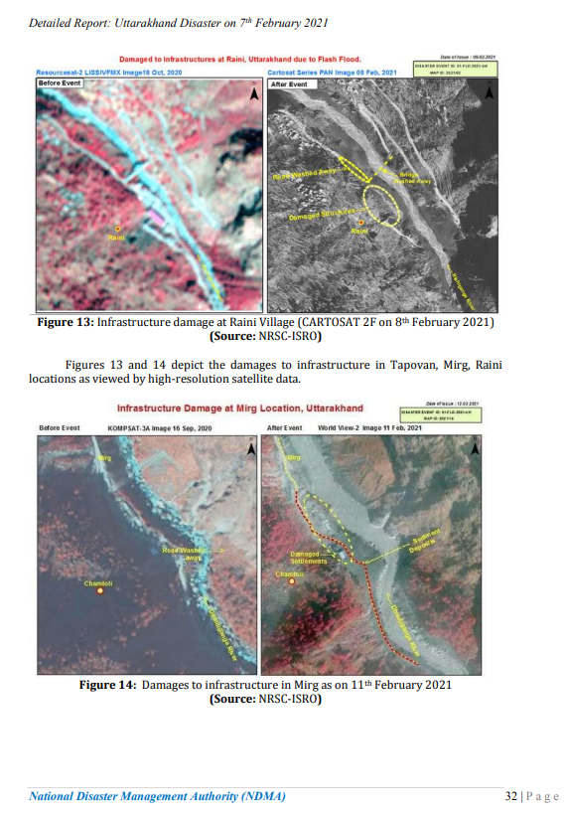
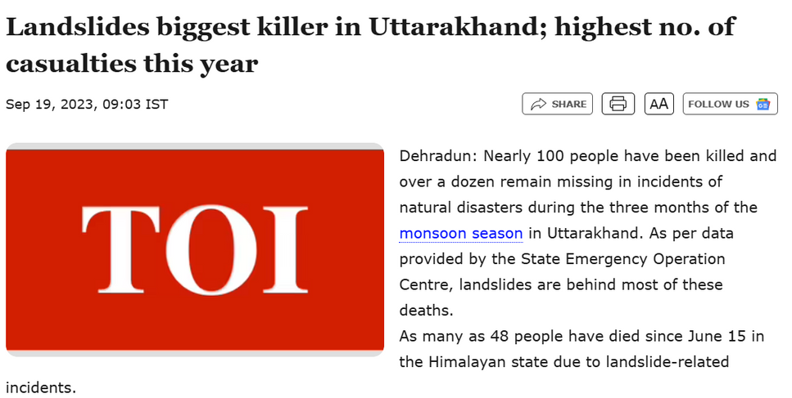
PROBLEM
SAFE HILLS
Uttarakhand
Landslides: A Growing Threat to the Hills of Uttarakhand
SDG Alignment
SDG 11 :
(Main focus)
Sustainable Cities
and Communities.
(Identifying high-risk
Landslide zones).
https://timesofindia.indiatimes.com/city/dehradun/monsoon-havoc-hits-uttarakhand-again-landslides-floods-expose-risks-of-unchecked-development/articleshow/123486852.cms
SDG 13 :
Climate Action (landslide risk forecasts based on weather patterns).
Despite being one of the most disaster-prone states, we still lack a predictive and centralized landslide monitoring system.
SDG 15 :
Life on Land (afforestation in vulnerable zones).
https://timesofindia.indiatimes.com/city/dehradun/landslides-biggest-killer-in-uttarakhand-highest-no-of-casualties-this-year/articleshow/103771839.cms
https://ndma.gov.in/sites/default/files/PDF/Reports/Detalied_report_UK_Disaster.pdf#:~:text=match%20at%20L1460%20affected%20villages,due%20to%20damage

Slide 3
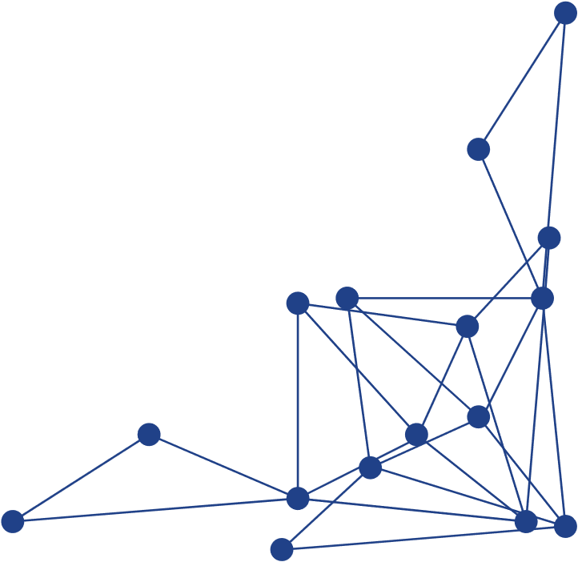

OUR SOLUTION
AI-Powered Forecasting for Safer Uttarakhand
Real-time Machine Learning + Earth Observation app.
Integrates terrain, rainfall, NDVI, geology, and drainage factors.
Forecasts next 7 days of landslide risk on demand.
Interactive dashboard for district-level visualization and decisions.
Data Collection
Feature Extraction
Pre Trained ML Model
Forecast Engine (On-Demand)
Dashboard Visualisation
Satellite datasets collected — including terrain (DEM), rainfall, vegetation, geology, and drainage data for Uttarakhand.
Derived parameters like slope, aspect, NDVI, land use, and distance from rivers to represent critical terrain and environmental factors.
A Random Forest Classifier trained on past landslide records and terrain factors predicts landslide probability and generates the Landslide Susceptibility Index.
The Open-Meteo API provides next-day rainfall forecasts when triggered, helping assess short-term landslide risk and update the dashboard with real-time weather insights.
A user-friendly dashboard displays color-coded susceptibility and forecast-based risk zones, enabling easy and informed decision-making.

Slide 4





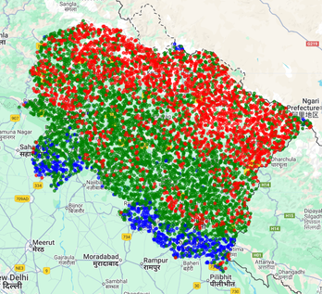
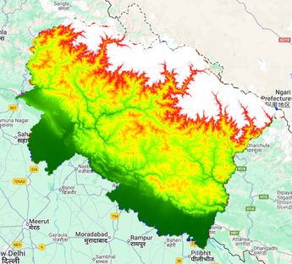
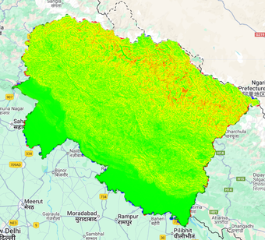
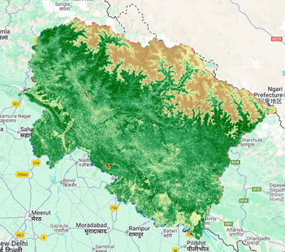
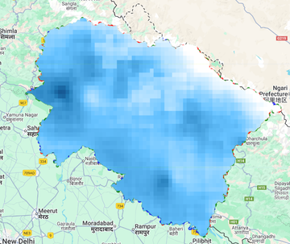
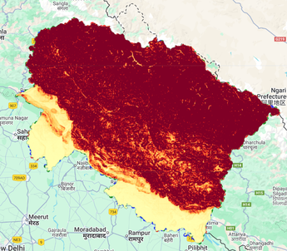

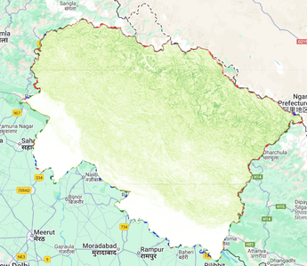
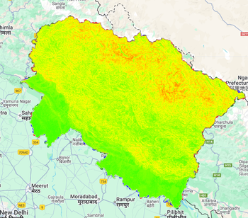
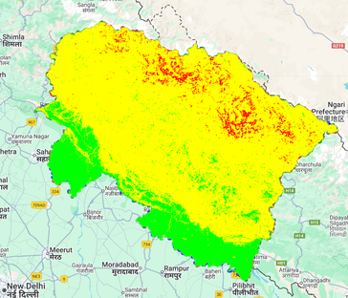
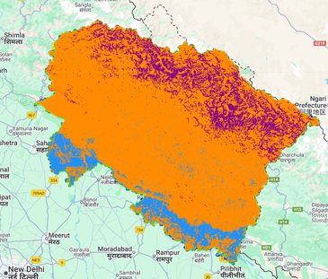
METHODOLOGY
DEM
NDVI
RAINFALL
GEOLOGY
DRAINAGE
(STRM 30m)
NASA
Derived Slope, elevation
Sentinal-2
ESA
Indicates vegetation cover
CHIRPS and Open-Metro
Past and forecast inputs
GSI and ESA
Lithology and land cover analysis
Derived from DEM
Distance from rivers
Training Points
DEM
Slope
PREPROCESSING:
Clipped datasets to Uttarakhand boundary.
Resampled to 30m resolution.
Normalized and stacked into layers.
NDVI
Rainfall
Geology
MODELLING and RISK MAPPING
A Random Forest Classifier trained on past landslide records and terrain factors predicts landslide probability.
A Weighted LSI approach integrates these parameters with assigned importance weights to refine susceptibility mapping.
Both outputs (ML prediction and Weighted LSI maps) highlight high-risk zones across Uttarakhand
Drainage
LSI
Weighted LSI
ML Prediction

Slide 5
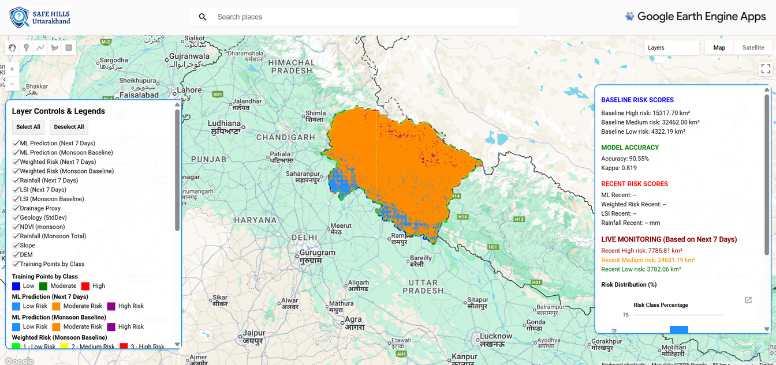
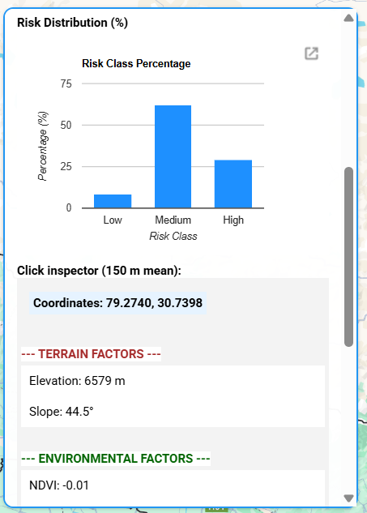
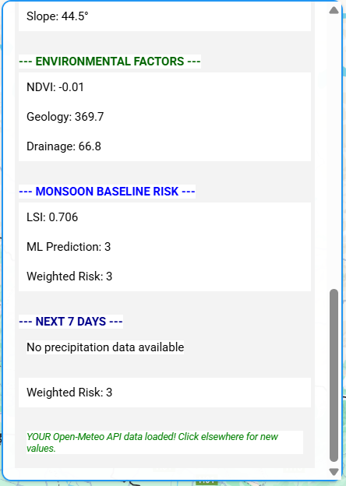
INTERACTIVE LANDSLIDE RISK DASHBOARD
See where the hills are safest - and where they’re not.
Next-Day Forecast - Used Open-Meteo API, Safe Hills fetches next-day rainfall forecasts on demand, giving users a quick view of short-term rainfall intensity that may elevate landslide risk.
Map Interface - Built on Google Earth Engine, the map lets users smoothly zoom, pan, and switch between layers.
Color - coded Risk Zones - The dashboard uses clear, feature-specific color legends for all layers, which data interpretation easier.
On-click inspector - By clicking on any point, users can instantly view the values of each layer, supporting quick site-specific evaluations.

Slide 6
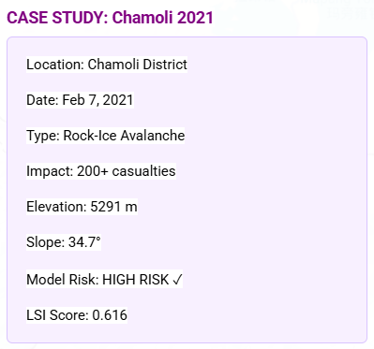
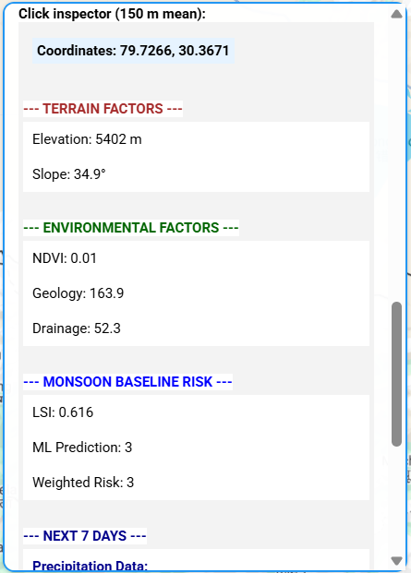
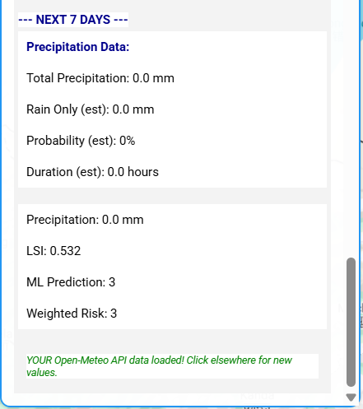

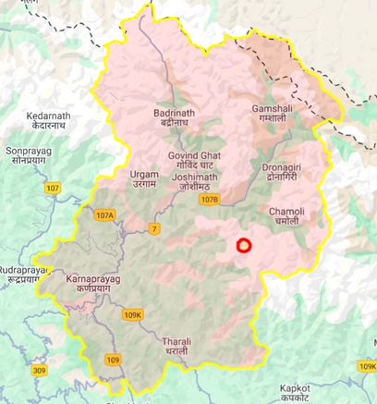
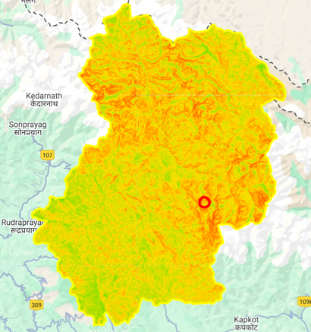
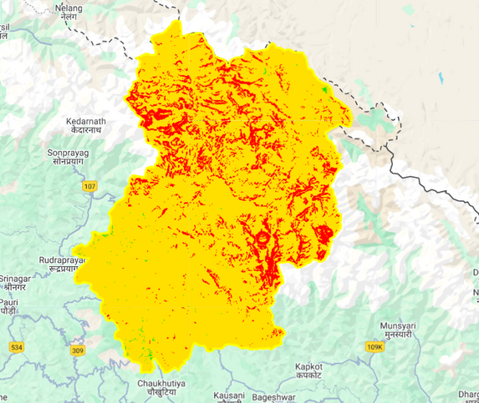

Case Study (Chamoli District)
Assessing Model Accuracy in Real-World Terrain
Our Analysis using Google Earth Engine
Location defined at (79.73° E, 30.37° N) with a 5 km buffer.
Extracted predictor values: elevation, slope, rainfall, NDVI, geology, drainage.
Ran our ML prediction model and calculated Landslide Susceptibility Index (LSI) for the same area.
Results (shown in the dashboard screenshot) indicate that the Chamoli site fell in “High Risk (Class 3)” zone.
Weighted risk 3 i.e. High Risk
Inference
The model correctly classified the 2021 Chamoli landslide area as highly susceptible.
Confirms that the Safe Hills Dashboard can successfully detect and flag high-risk zones before disaster strikes.
Chamoli District Boundary and exact location of the landslide
LSI Risk scores
Red - High | Yellow - Medium | Green - Low
Weighted Risk scores
Red - High | Yellow - Medium | Green - Low

Slide 7
WHAT MAKES OUR APP INNOVATIVE?
MEASURABLE IMPACT
Existing Tools | Safe Hills
Static hazard zonation maps | Live ML prediction with daily updates
Manual risk classification | Automated Random Forest classification
No integration of real-time weather | Open-Meteo API + dynamic rainfall forecast
Poor user visualization | Dual interactive sidebars (layers + analytics)
Characteristic | Impact
Accuracy | >85%
Prediction window | Next 7 Days (On demand)
Coverage | Entire Uttarakhand (13 districts)
Actionable outputs | Risk maps, rainfall probability, affected area
Stakeholders | SDRF, disaster control offices, local panchayats
First model to combine ML-based baseline + 7-day rainfall forecast on Google Earth Engine with UI-based decision support.
THE ASK -
SCALING SAFE SLOPES
Seeking collaboration with NDMA or Uttarakhand SDRF for pilot deployment & integration into disaster alert systems.

Slide 8

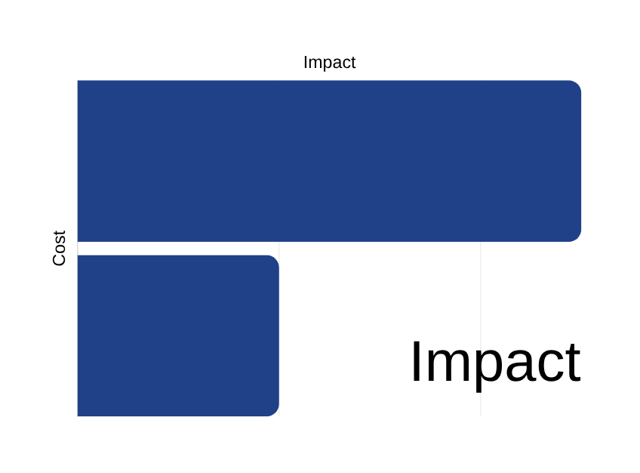
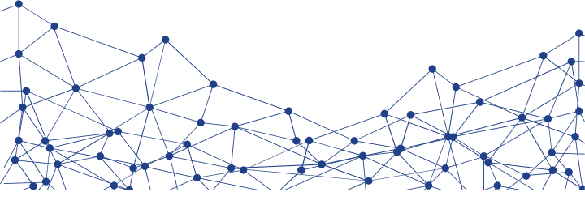
SCALING SAFE HILLS — FROM PROTOTYPE TO IMPACT
Built for Real Use
Runs entirely on Google Earth Engine (no servers).
Low-cost & scalable across Himalayan states.
Maintenance: Retraining after every 4 months.
Vision Ahead
Integrate with NDMA / ISRO BHUVAN.
Enable district-level early warnings.
Predict. Prepare. Prevent.
Feature | Conventional Systems | Safe Hills
Infrastructure | High | Cloud-based (Low)
Cost | High | Minimal
Coverage | Limited | Scalable
Maintenance | Complex | Every 4 months
Safe Hills
Conventional Systems

Slide 9
SAFE HILLS
Uttarakhand
THANK YOU
FOR YOUR TIME AND ATTENTION

